Slide 1
SCC211 Operation System
(Going Deeper)
Zhang Jinyu – zjy@bjtu.edu.cn
School of Computer and Information Technology
SD408

Slide 2
Problem with Variable Size Regions
Suffer external fragmentation*
Segmentation (as opposed to paging) just one such scheme
Also see same problem with non-block based file-systems
Dynamic Storage Allocation
First fit
Always allocate first region of sufficient size found
Best fit
Always allocate smallest memory hole of sufficient size
Worst fit
Always allocate largest memory hole (of sufficient size)
* Remember that unlike page/ block based schemes fragmentation not constrained by (page/ block) allocation size or by process/ file lifetime

Slide 3
Dynamic Storage Allocation Example
考试题
Given memory partitions of
100K, 500K, 200K, 300K, and 600K (in order)
And requests for
– 212K, 417K, 112K, 426K (in order)
How would these be serviced by
First fit
Best fit
Worst fit

Slide 4

First Fit
Given memory partitions of
– 100K, 500K, 200K, 300K, and 600K (in order)
And requests for
– 212K, 417K, 112K, 426K (in order)

Slide 5
Assumptions
Free regions
Sizes in 100K
Assume something used between them
We can’t combine these free regions

Slide 6
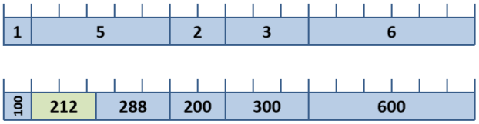
First Fit
Requests for
212K, 417K, 112K, 426K (in order)

Slide 7
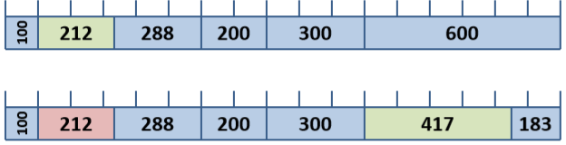
First Fit
Requests for
212K, 417K, 112K, 426K (in order)

Slide 8
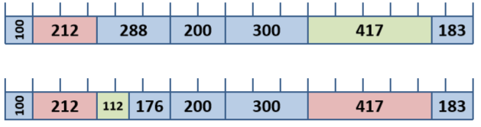
First Fit
Requests for
212K, 417K, 112K, 426K (in order)

Slide 9
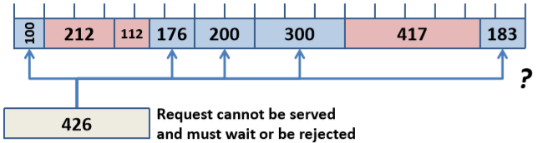
First Fit
Requests for
212K, 417K, 112K, 426K (in order)

Slide 10
Best Fit
Given memory partitions of
100K, 500K, 200K, 300K, and 600K (in order)
And requests for
212K, 417K, 112K, 426K (in order)

Slide 11
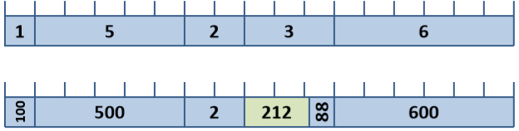
Best Fit
Requests for
212K, 417K, 112K, 426K (in order)

Slide 12
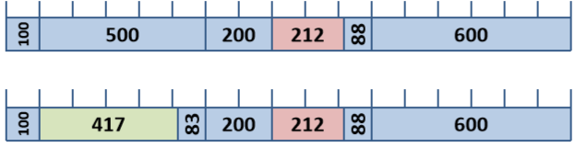
Best Fit
Requests for
212K, 417K, 112K, 426K (in order)

Slide 13
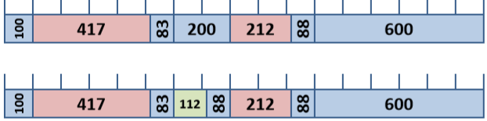
Best Fit
Requests for
212K, 417K, 112K, 426K (in order)

Slide 14
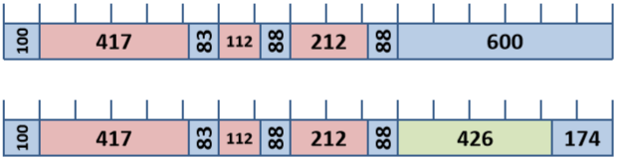
Best Fit
Requests for
212K, 417K, 112K, 426K (in order)
Notice that all requests have been serviced

Slide 15
Worst Fit
Given memory partitions of
100K, 500K, 200K, 300K, and 600K (in order)
And requests for
212K, 417K, 112K, 426K (in order)

Slide 16
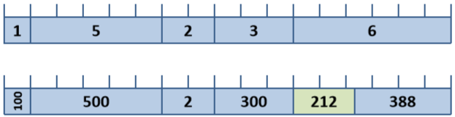
Worst Fit
Requests for
212K, 417K, 112K, 426K (in order)

Slide 17
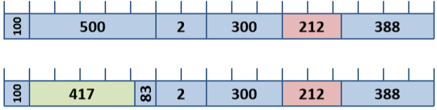
Worst Fit
Requests for
212K, 417K, 112K, 426K (in order)

Slide 18
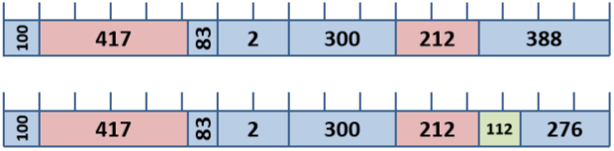
Worst Fit
Requests for
212K, 417K, 112K, 426K (in order)

Slide 19
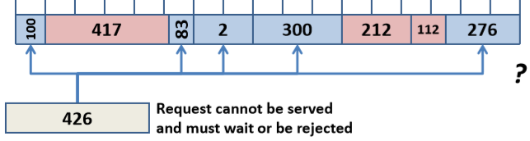
Worst Fit
Requests for
212K, 417K, 112K, 426K (in order)

Slide 20
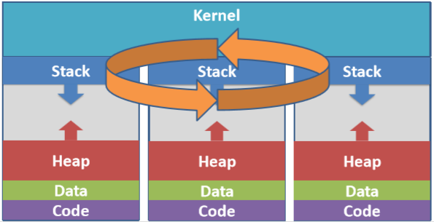
Scheduling multiple processes
Scheduler picks next process
Selected process then dispatched to run on CPU

Slide 21
Scheduling Criteria
CPU Utilization (max 100%, often given as number 0..1)
Percentage of time CPU running application code
Throughput
Number of processes completed per unit time (obv. depends on size)
Turnaround time
Time between process submission and completion
Waiting time
Sum of time waiting in Ready Queue (i.e. it could run/ use CPU)
Response time
Time between submission and start of first output/ interaction
越多越好
考试题
到达到完成
到达到开始执行
排好队后，可能有优先级抢占
rt>wt
CPU利用率(最大值100%，通常用数字0..1表示)
CPU运行应用程序代码的时间百分比
吞吐量
单位时间内完成的流程数(显然，取决于规模)
周转时间
过程提交和完成之间的时间
等待时间
在准备队列中等待的时间之和(即它可以运行/使用CPU)
响应时间
提交和开始第一次输出/交互之间的时间

Slide 22
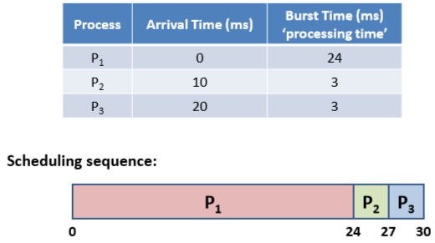
First Come, First Served (FCFS)
Simple FIFO queue of runnable processes
执行时间
吞吐量 3/0.03=100

Slide 23
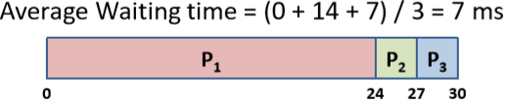
Some Useful Values
Average Waiting Time
Average time processes wait in Ready Queue
Waiting Times (dispatch time – arrival time)
P1: 0 – 0 ms = 0 ms
P2: 24 – 10 ms = 14 ms
P3: 27 – 20 ms = 7 ms

Slide 24

Some Useful Values
Average Turnaround Time
Average time between submission and completion
Turnaround Times (completion – arrival time)
P1: 24 – 0 ms = 24 ms
P2: 27 – 10 ms = 17 ms
P3: 30 – 20 ms = 10 ms

Slide 25
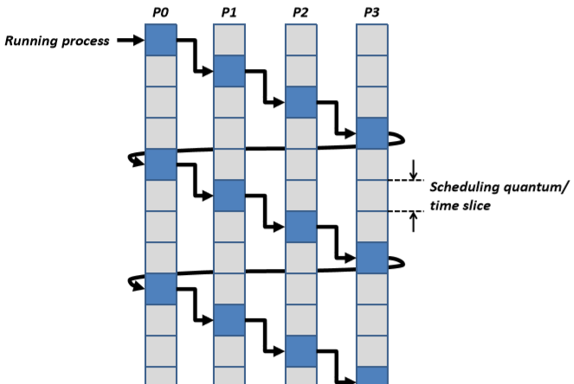
Round-Robin Scheduling
考试题模板

Slide 26
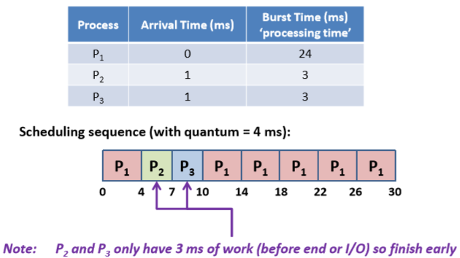
Round Robin (RR)
Pre-emptive scheduler with set time quantum
每个进程轮流用4ms
注意：如果单次完成时间<4m，则提前结束

Slide 27
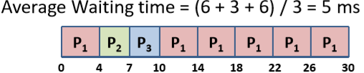
Some Useful Values
Average Waiting Time
Average time processes wait in Ready Queue
Waiting Times (dispatch time – arrival time)
P1: (0 – 0) + (10 – 4) ms = 6 ms
P2: 4 – 1 ms = 3 ms
P3: 7 – 1 ms = 6 ms

Slide 28
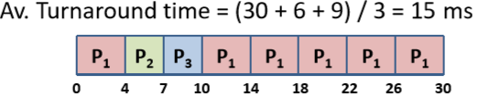
Some Useful Values
Average Turnaround Time
Average time between submission and completion
Turnaround Times (completion – arrival time)
P1: 30 – 0 ms = 30 ms
P2: 7 – 1 ms = 6 ms
P3: 10 – 1 ms = 9 ms

Slide 29
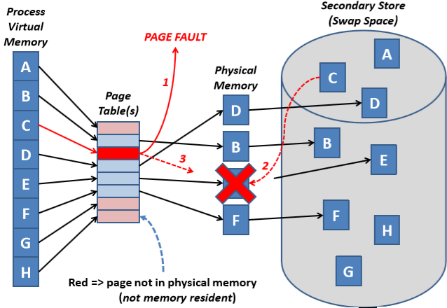
Page Frame Replacement

Slide 30
Page Replacement
Saw two simple algorithms
First In, First Out (FIFO)
Simple but can exhibit unexpected behavior *
Least Recently Used (LRU)
* For interest, see Belady’s anomaly in course text (adding more frames can increase page faults)

Slide 31
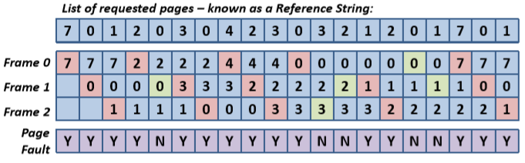
First In, First Out (FIFO)
硬盘最慢
Assume three available memory frames
Requested pages are loaded into these frames
执行时需要页的顺序
Notice how page faults (red squares) cycle
Green squares indicate request for page already present in a memory frame

Slide 32
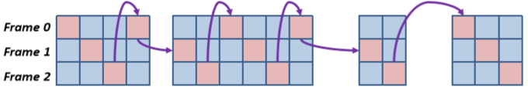
First In, First Out (FIFO)
Notice how page faults (red squares) cycle

Slide 33
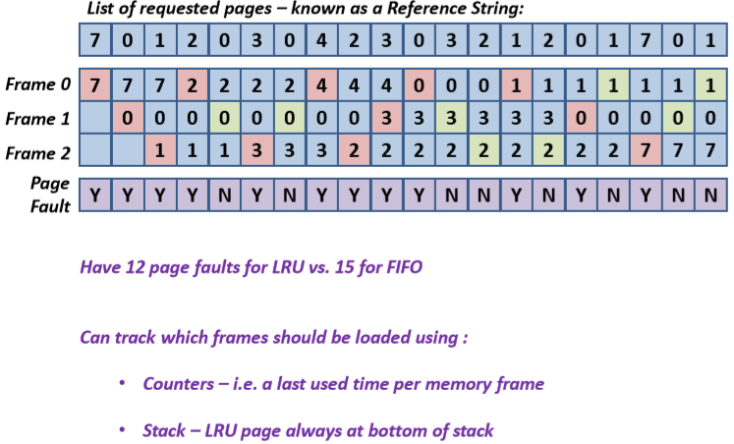
Least Recently Used (LRU)

Slide 34
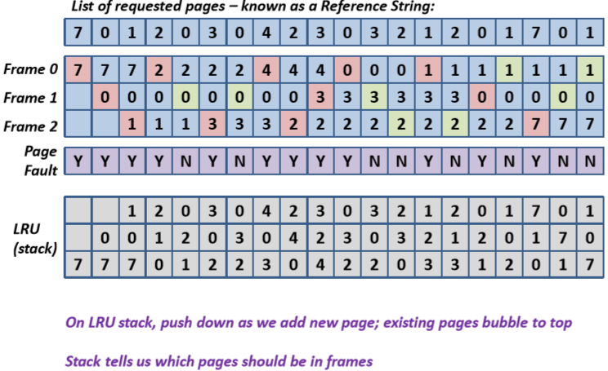
Least Recently Used: Stack approach
顶
考试题

Slide 35
In practice, processes don’t request pages… Need mechanisms to handle sub-page and multi-page requests
NON-PAGE BASED ALLOCATION

Slide 36
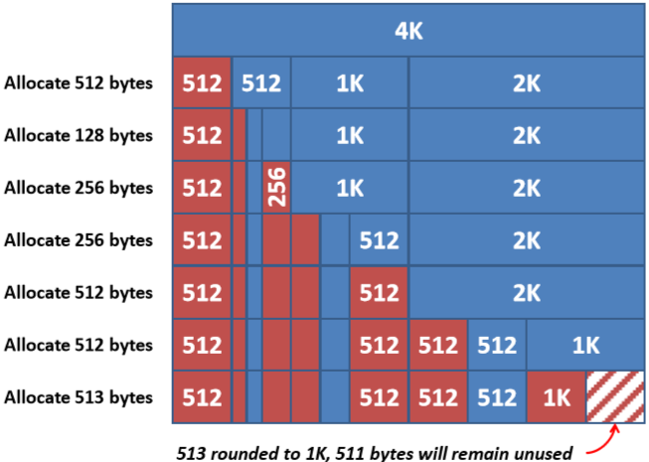
Buddy Allocation Example
考试题，作业

Slide 37
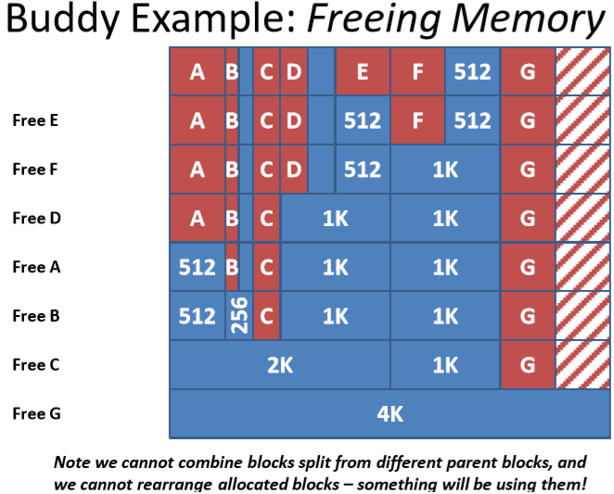
Buddy Example: Freeing Memory
无先后顺序
刚好合并
根据切的关系合并，不可跨域

Slide 38
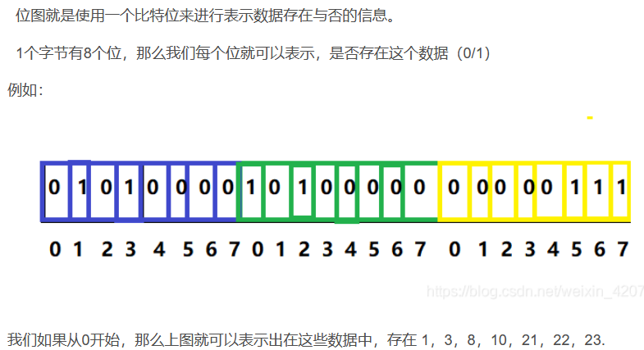
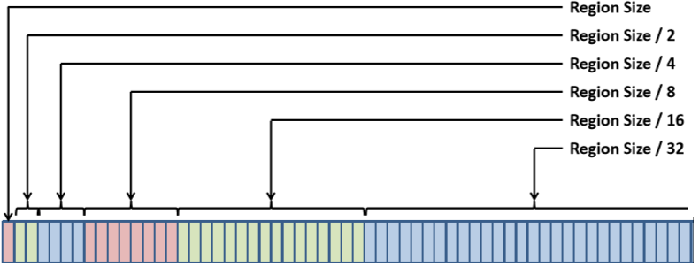
Bitmap allocation
位图
使用一个bit表示该数字是否存在
Rather than maintaining a list
Often keep (bit based) allocation map
Compact and fast to search for free entries

Slide 39
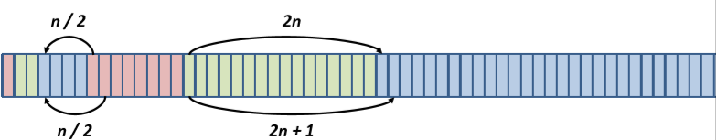
Bitmap Allocation
With integer arithmetic/ shifts, easy to find
Parent:
Children: 2n and 2n + 1
Note that flipping one bit in a block address will give address of block’s buddy

Slide 40
Question？

